Slide 1
Generalized Method of Cells
Michael Kaplan
Rehan Nawaz

Slide 2
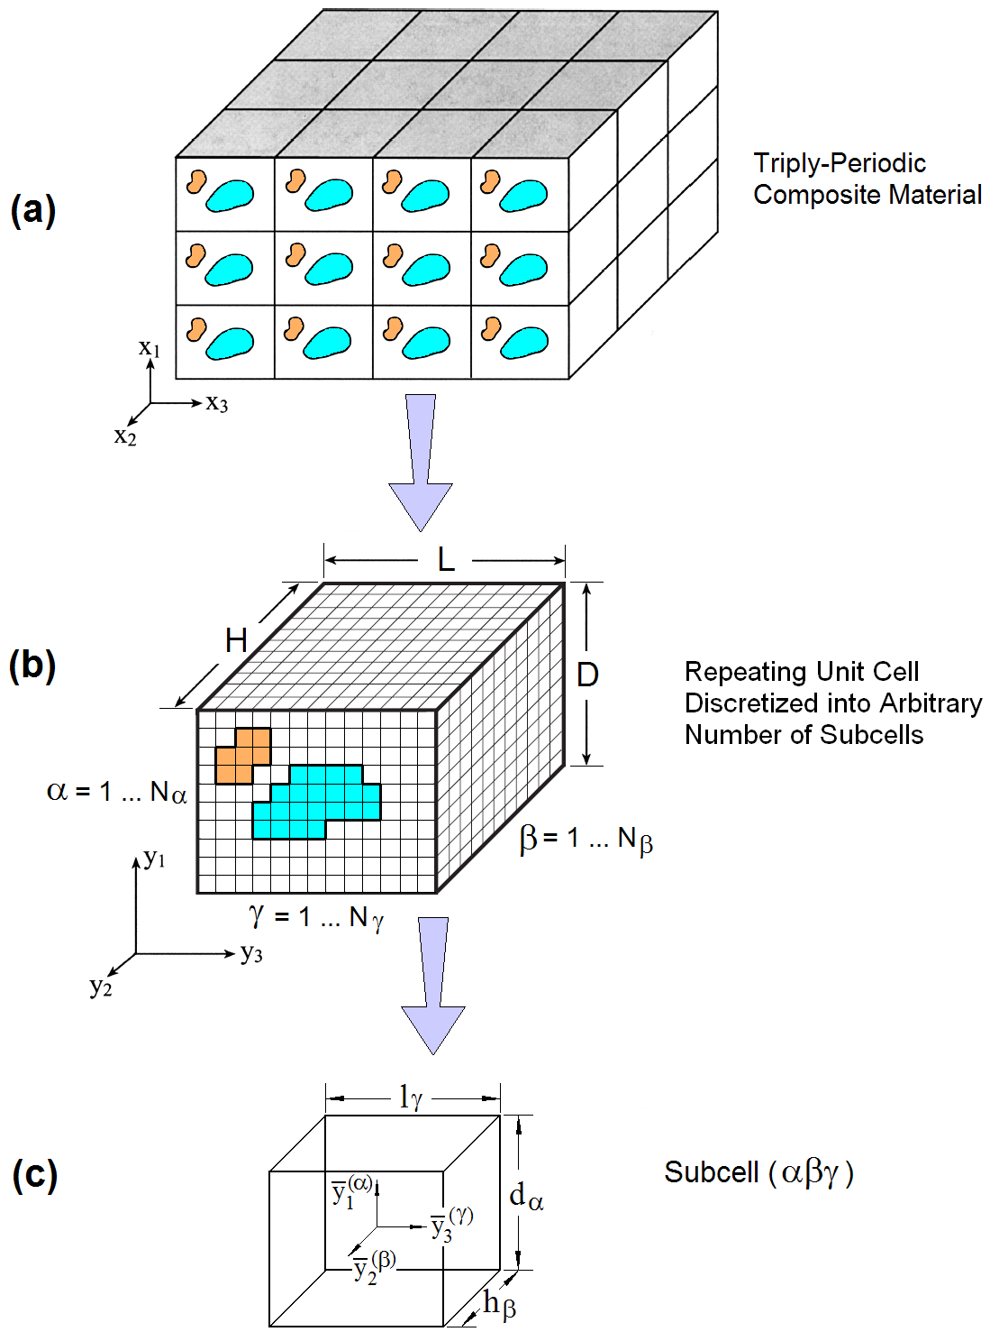
Background
Micromechanics at the constituent level is needed to model composites
Micromechanics takes into account the packing of the fibers
The generalized method of cells is an efficient way of modeling the micromechanics

Slide 3
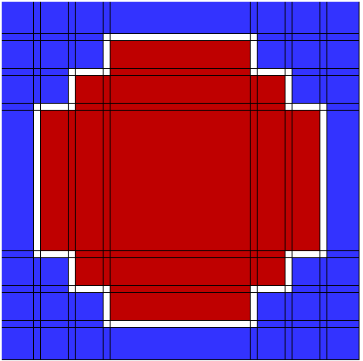
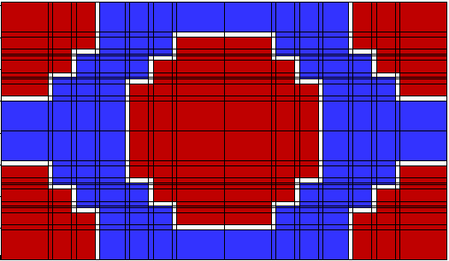
The Method
The RUC is partitioned into rectangular subcells
Many packing structures can be created
Boundary conditions are applied as an average across each subcell boundary

